Slide 1
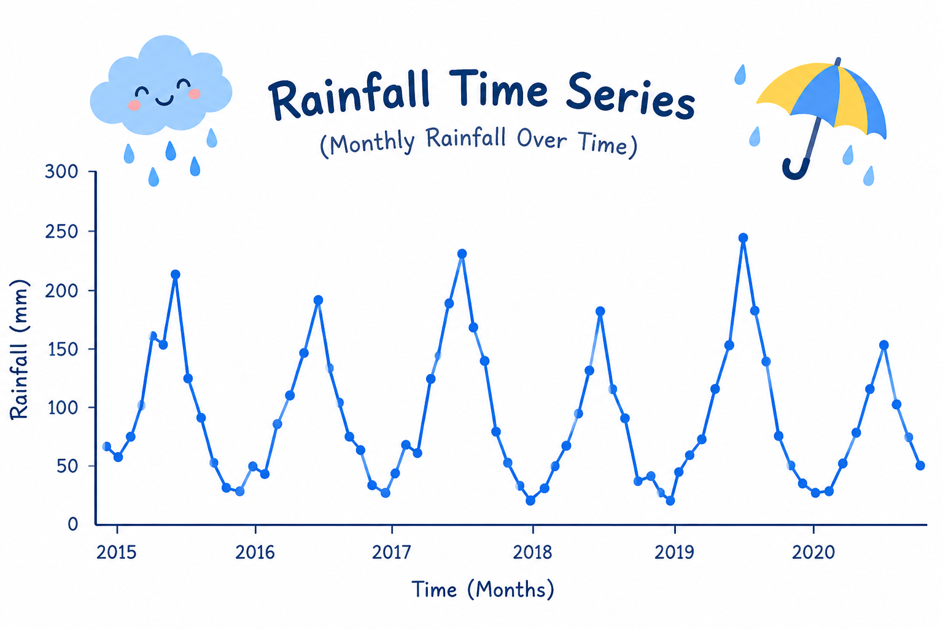
PRAICP-1004 — Rainfall Time Series Forecasting
Submitted By: Sameeksha
Team Code: PTID-AIE-JUL-26-11142
Project Domain: Time Series Forecasting & Machine Learning

Slide 2
TABLE OF CONTENTS
Problem Statement & Project Objectives
Dataset Overview
Project Workflow
Exploratory Data Analysis
Time Series Analysis
Data Preparation & Feature Engineering
Model Building & Training
Model Evaluation & Comparison
Hyperparameter Tuning
Rainfall Forecasting
Highest Daily Rainfall Forecast
Business Insights
Challenges Faced
Final Conclusion
Model Output & Predictions

Slide 3
1. PROBLEM STATEMENT & PROJECT OBJECTIVES
Project Objectives
Analyze historical rainfall patterns using time-series techniques.
Perform Exploratory Data Analysis to identify trends and seasonality.
Prepare and transform rainfall data for forecasting.
Develop statistical and machine-learning forecasting models.
Compare models using appropriate evaluation metrics.
Tune the selected machine-learning model.
Forecast total monthly rainfall for the next 12 months.
Forecast the highest daily rainfall expected for upcoming months.
Generate actionable insights for rainfall and resource planning.
Problem Statement
The objective of this project is to develop a forecasting system that analyzes historical rainfall patterns and predicts future rainfall using time-series and machine-learning techniques.
Accurate rainfall forecasting can support planning related to water resources, drainage, agriculture, infrastructure and extreme-rainfall preparedness.

Slide 4
2. DATASET OVERVIEW
Dataset: Rainfall Time Series Dataset
Source: DataMites Capstone Project Dataset
Problem Type: Time Series Forecasting
Location: Changi Climate Station
Time Period: January 1982 – June 2020
Records: 462 monthly observations
7. Main Variables
Total Monthly Rainfall
Highest Daily Rainfall
Number of Rain Days
Month / Date
8. Target Forecasts
1. Total Monthly Rainfall
2. Highest Daily Rainfall

Slide 5
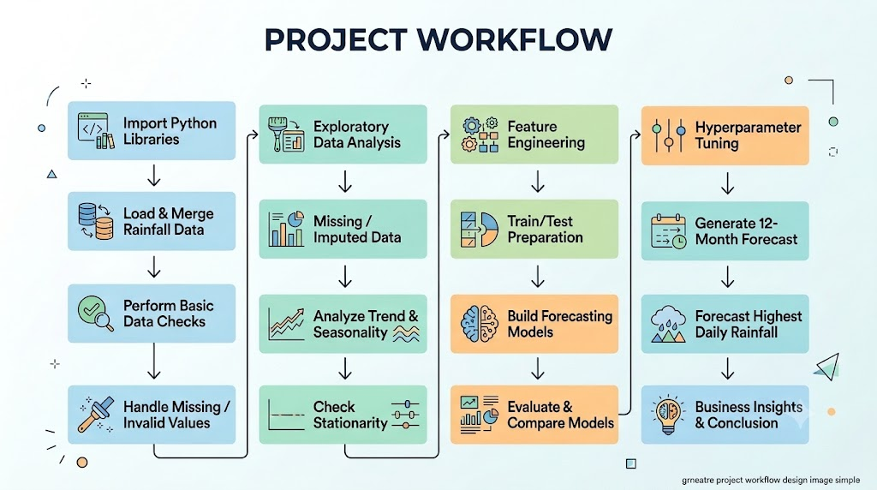
3. PROJECT WORKFLOW

Slide 6
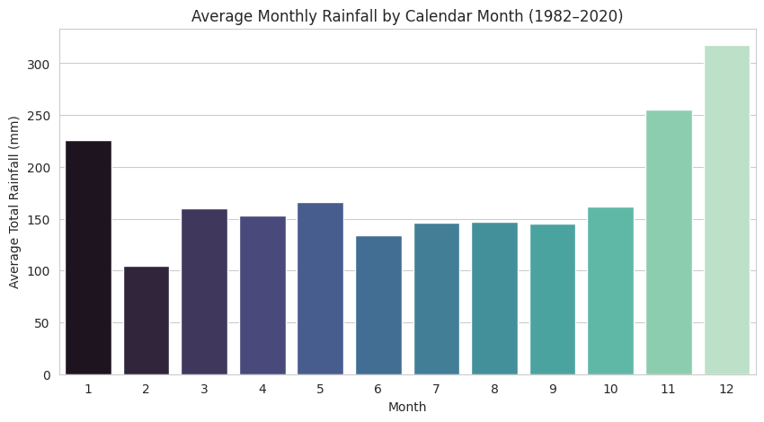
4. EXPLORATORY DATA ANALYSIS
EDA Findings
Dataset contains 462 monthly observations.
Historical rainfall data spans multiple decades.
Monthly rainfall shows considerable variation over time.
Recurring seasonal patterns are observed.
Rainfall variables have different distributions.
Extreme rainfall observations are present.
Relationships between rainfall variables were analyzed.
Seasonal decomposition was performed to understand trend,
seasonality and residual variation.
Purpose of EDA
To understand the underlying rainfall behaviour before selecting and training forecasting models.

Slide 7
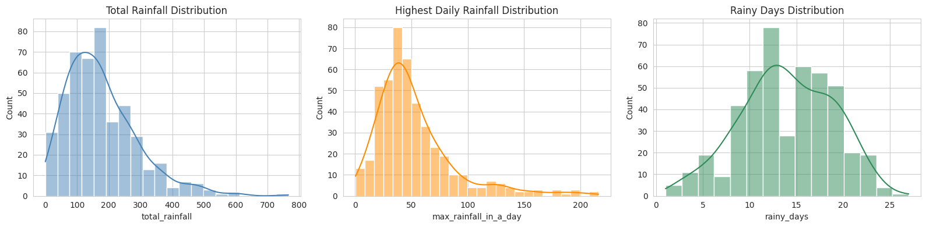
5. TIME SERIES TREND ANALYSIS
Historical Monthly Rainfall
The historical rainfall series was visualized to identify:
Long-term rainfall behaviour
Seasonal fluctuations
High-rainfall periods
Low-rainfall periods
Variability across years
Key Observation
Rainfall exhibits recurring fluctuations over time, indicating the importance of incorporating seasonal behaviour into forecasting.

Slide 8
6. DATA PREPARATION & FEATURE ENGINEERING
Data Preparation
Converted the month column into DateTime format.
Sorted observations chronologically.
Set the month as the time-series index.
Verified monthly continuity.
Checked missing values and duplicates.
Feature Engineering
Created time-dependent features such as:
Month Number
Year
Lag 1 → Previous month's rainfall
Lag 2 → Rainfall two months earlier
Lag 3 → Rainfall three months earlier
Lag 12 → Rainfall in the same month of the previous year
12-Month Rolling Mean

Slide 9
7. MODEL BUILDING & TRAINING
Models Used: The project compares:
SARIMA
Linear Regression
Random Forest Regressor
Gradient Boosting Regressor
XGBoost Regressor
Modeling Strategy
Note:Both classical statistical forecasting and machine-learning approaches were evaluated to determine how effectively they capture rainfall behaviour.

Slide 10
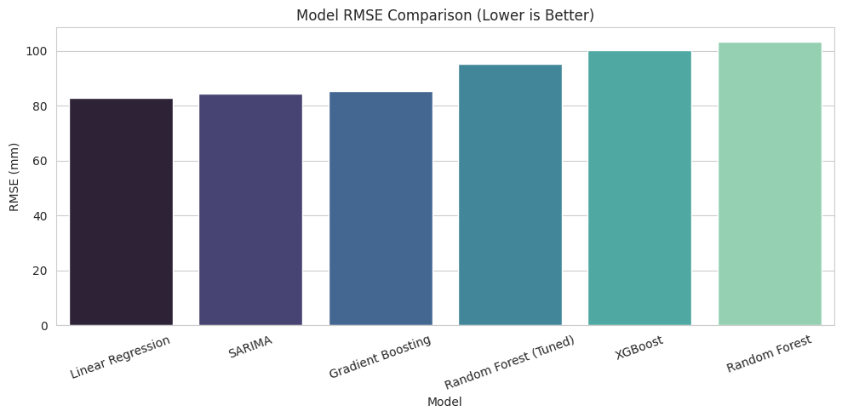
8. MODEL EVALUATION &MODEL COMPARISON
Evaluation Metrics
1.MAE — Mean Absolute Error
Measures the average absolute difference between actual and predicted rainfall.
Lower → Better
2.RMSE — Root Mean Squared Error
Penalizes larger prediction errors more strongly.
Lower → Better
3.R² — R-Squared
Measures how much variation in the target is explained by the model.
Higher → Better

Slide 11
9. HYPERPARAMETER TUNING
Objective:Improve model performance and generalization by identifying suitable model parameters.
Technique 1.GridSearchCV 2.TimeSeriesSplit: Traditional random cross-validation can cause future information to influence training.
3.TimeSeriesSplit maintains chronological order:
Past → Training
Future → Validation

Slide 12
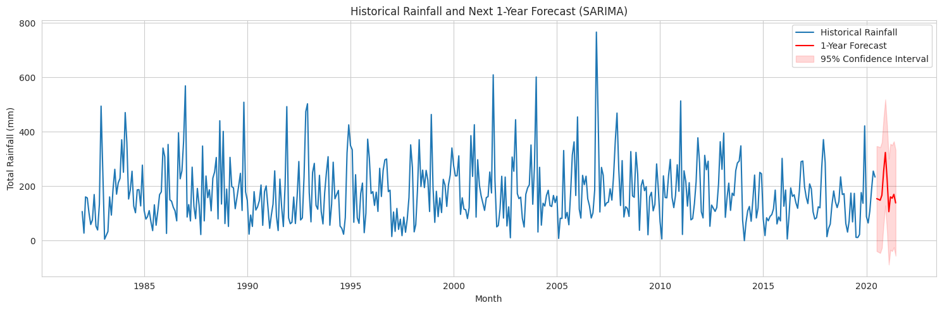
10. 12-MONTH RAINFALL FORECAST

Slide 13
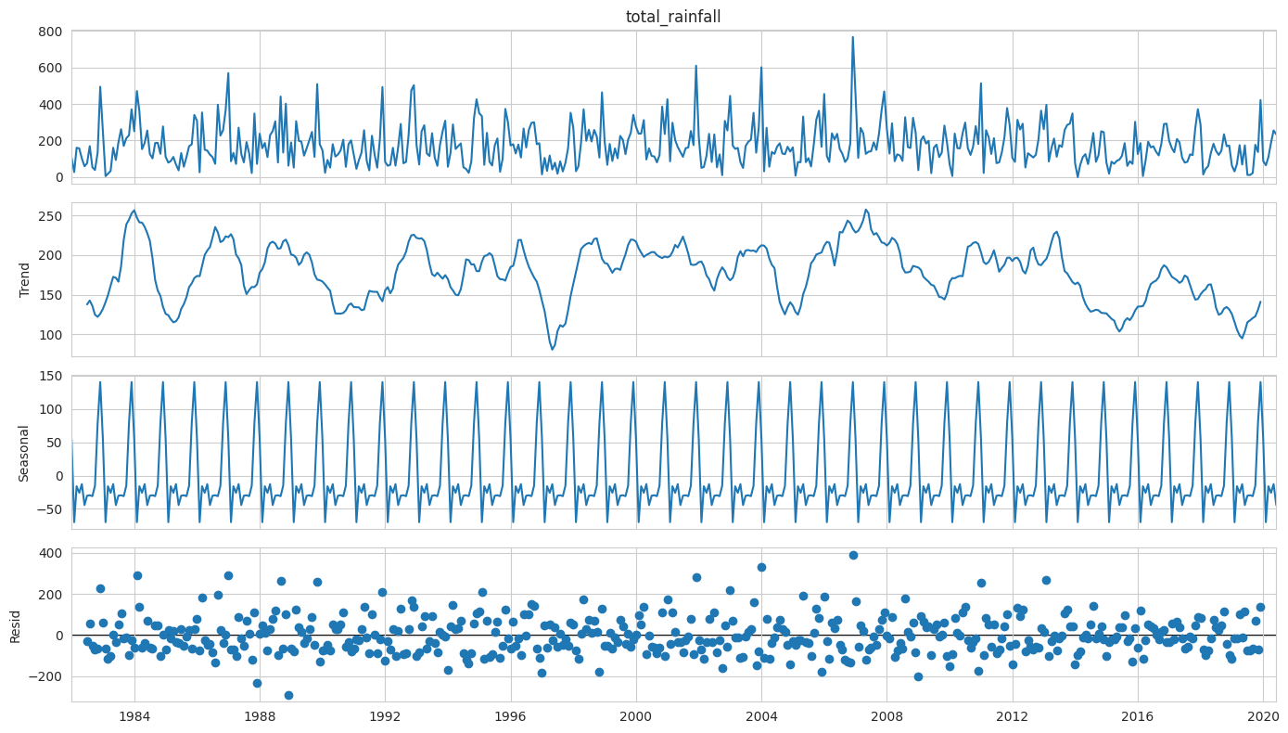
11. HIGHEST DAILY RAINFALL FORECAST

Slide 14
12. BUSINESS INSIGHTS
1. Seasonal Planning
Historical seasonal patterns can support rainfall-sensitive planning.
2. Water Resource Management
Forecasts can assist in planning water storage and resource allocation.
3. Flood Preparedness
Forecasting extreme rainfall can provide useful information for preparedness planning.
4. Infrastructure Planning
Rainfall patterns can support drainage and infrastructure considerations.
5. Agricultural Planning
Seasonal rainfall information can support rainfall-dependent activities.
6. Continuous Monitoring
Models can be retrained as new rainfall observations become available.

Slide 15
13. CHALLENGES FACED
Working with long-term time-series data
Maintaining chronological order during modelling
Identifying and handling seasonal patterns
Selecting suitable forecasting approaches
Creating meaningful lag and rolling features
Avoiding data leakage during model validation
Comparing statistical and ML models fairly
Performing multi-step future forecasting
Handling rainfall variability and extreme observations

Slide 16
14. FINAL CONCLUSION
Successfully analyzed historical rainfall time-series data.
Identified important trends and seasonal patterns.
Performed time-series decomposition and stationarity analysis.
Engineered lag, calendar and rolling features.
Developed statistical and machine-learning forecasting models.
Evaluated models using MAE, RMSE and R².
Applied time-series-aware hyperparameter tuning.
Generated a 12-month rainfall forecast.
Forecasted monthly highest daily rainfall.
Derived practical insights for rainfall-related planning.

Slide 17
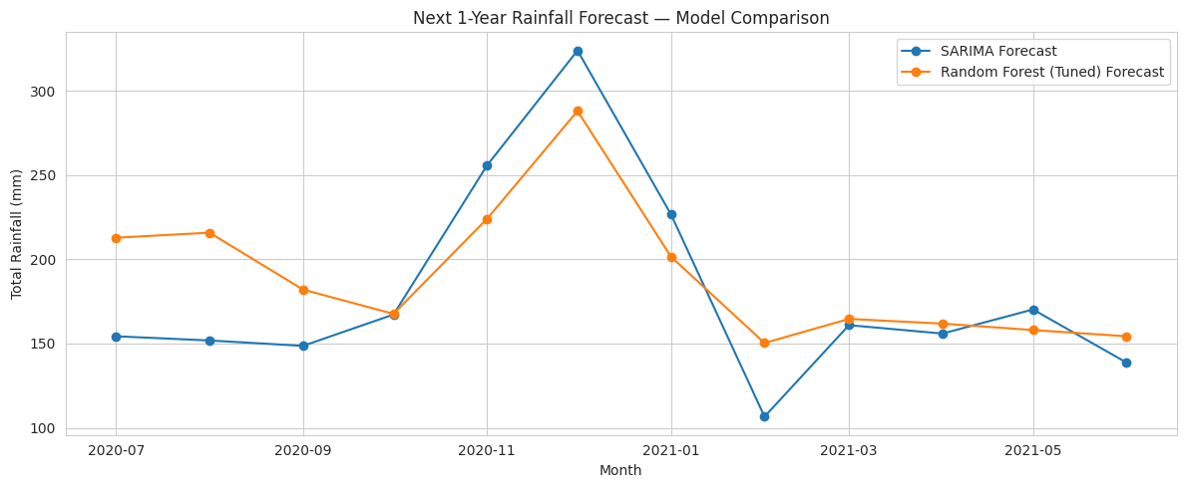
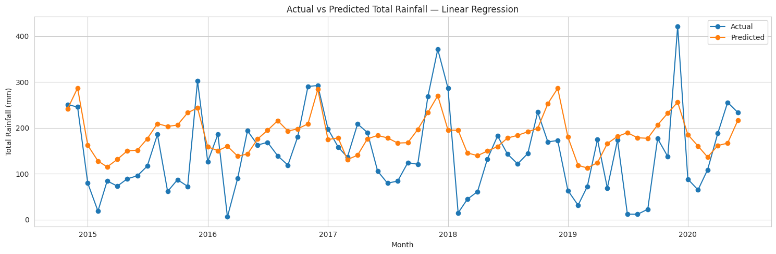
15.MODEL OUTPUT & PREDICTIONS

Slide 18
THANK YOU!!

